Slide 1


Ad-Hoc Insights
Consumer Goods

Slide 2
AtliQ Hardwares (abstract company) is one of India’s leading computer hardware manufacturers and has also established A strong presence in international markets.
OBJECTIVES
Despite this growth, the management realized that they lacked timely and actionable insights to support quick, data-driven decision-making.
To address this gap, the company decided to expand its data analytics team by hiring several junior data analysts.
Tony Sharma, the director of data analytics, was looking for candidates who could demonstrate both strong technical expertise and effective communication skills.
To evaluate these abilities, he designed A SQL challenge that would assess not only the candidates’ technical proficiency but also their problem-solving and business understanding.
The company seeks insights for 10 Ad-Hoc Business requests.

Slide 3
COMPANY DETAILS
AtliQ Hardware is a computer hardware and accessories manufacturer
Category
Motherboard
Mouse
Keyboard
Batteries
Personal Laptop
Business Laptop
Gaming Laptop
Personal Desktop
External SSD
USB Flash Drive
Wi-fi Extender
Segment
Peripherals
Accessories
Notebook
Desktop
Storage
Networking
Division
P & A
PC
N & C
Fiscal Years
September 2019 – August 2020
(FY 2020)
September 2020 – August 2021
(FY 2021)

Slide 4
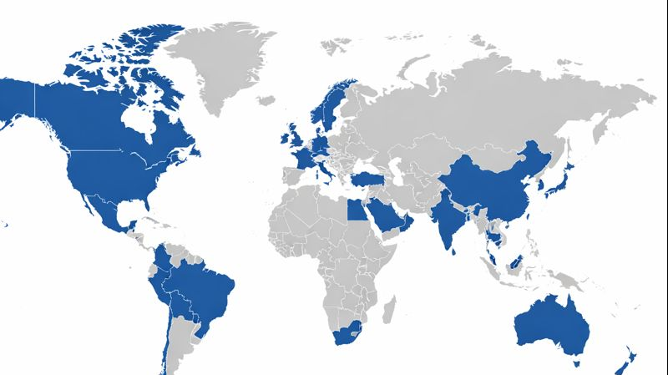
COMPANY MARKETS
NA
USA
CANADA
EMEA
France
Germany
Italy
Netherlands
Norway
Poland
Portugal
Spain
Sweden
Austria
United Kingdom
APAC
India
Indonesia
Japan
Pakistan
Philippines
South Korea
Australia
New Zealand
Bangladesh
China
LATAM
Mexico
Brazil
Chile
Columbia

Slide 5
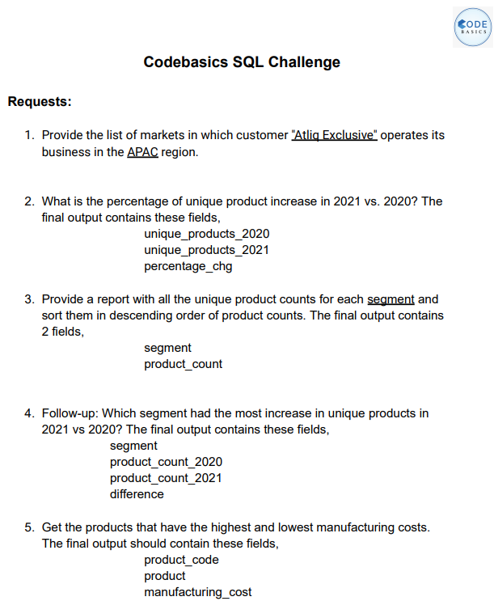
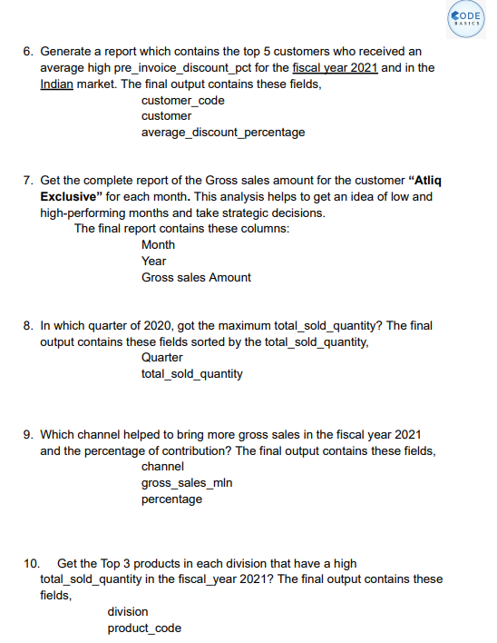
BUSINESS REQUESTS

Slide 6
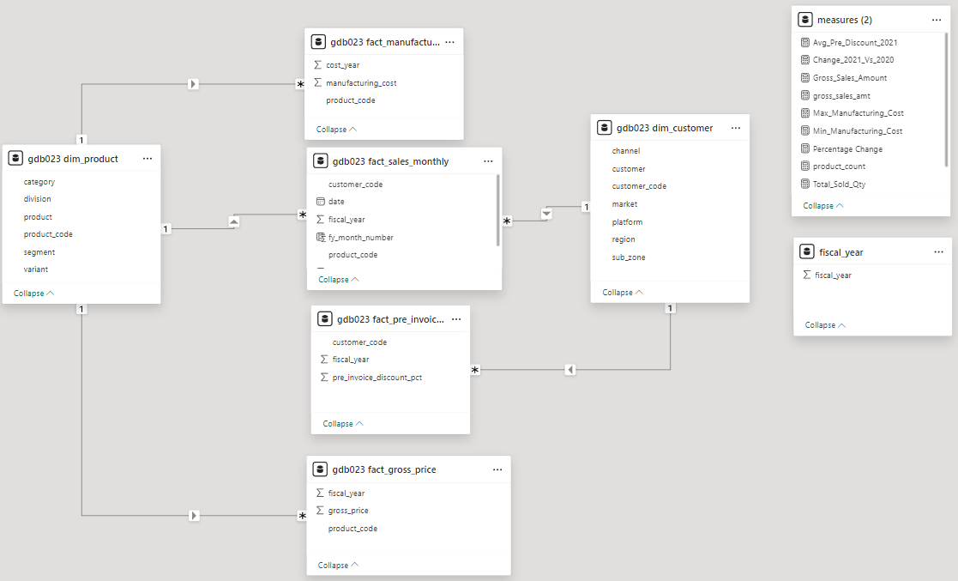
DATA MODEL
Tools Used
MySQL
Power BI

Slide 7
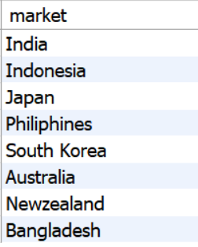
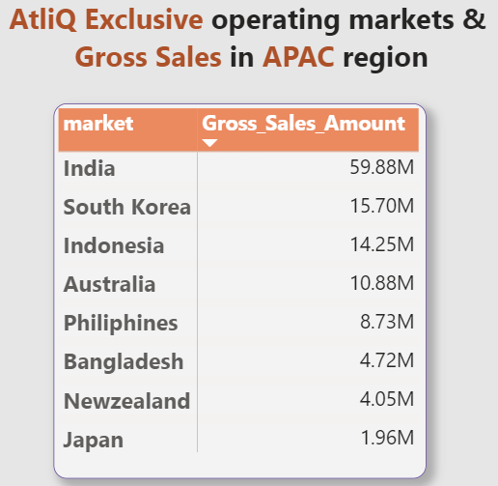
1. Provide the list of markets in which customer "AtliQ Exclusive" operates its business in the APAC region.

Slide 8
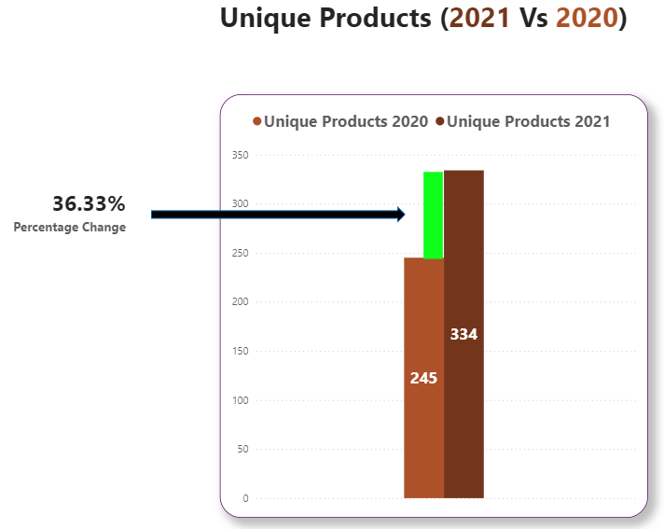
2. What is the percentage of unique product increase in 2021 vs. 2020? The final output contains these fields: unique_products_2020 , unique_products_2021 , percentage_chg.
INSIGHTS
89 New Products have been introduced in fiscal year 2021.
Production has increased.

Slide 9
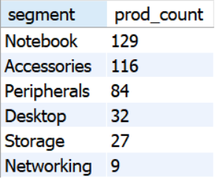
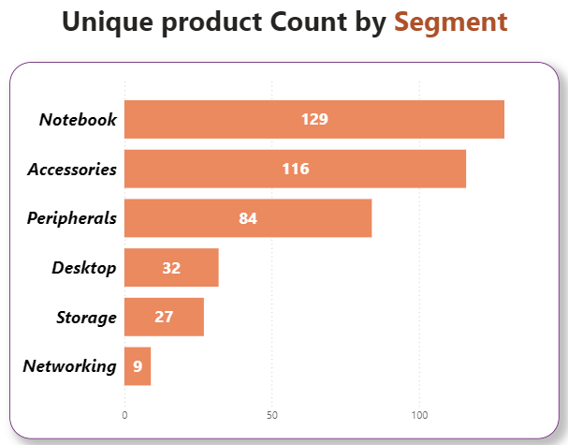
3. Provide a report with all the unique product counts for each segment and sort them in descending order of product counts.
The final output contains 2 fields: segment , product_count.
INSIGHTS
Peripherals, Accessories & Notebooks are amongst top segments to have new products introduced.

Slide 10
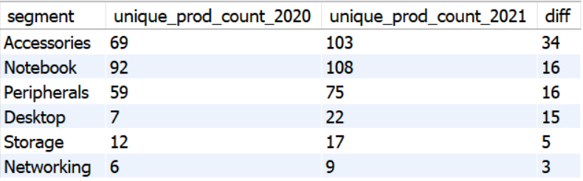
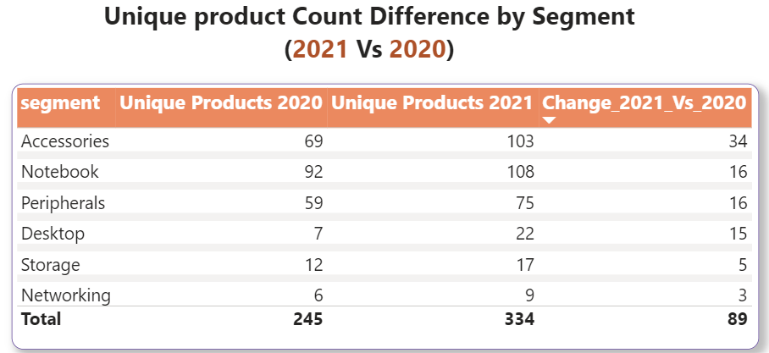
4. Follow-up: Which segment had the most increase in unique products in 2021 vs 2020? The final output contains these fields:
Segment , product_count_2020 , product_count_2021 , difference.
INSIGHTS
Accessories had the largest increase in production.
Storage & Networking are showing slower production growth than other segments.

Slide 11
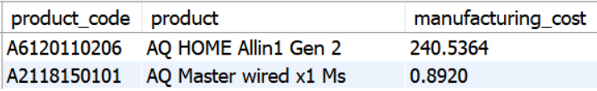
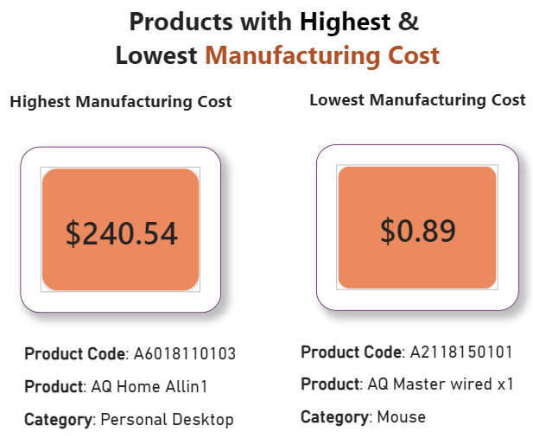
5. Get the products that have the highest and lowest manufacturing costs. The final output should contain these fields: product code , product , manufacturing cost.
INSIGHTS
Mouse – AQ Master wired x 1 (Variant – Standard 1) has the lowest Manufacturing Cost.
Personal Desktop – AQ Home Allin 1 (Variant – Standard 3) has the highest Manufacturing Cost.

Slide 12
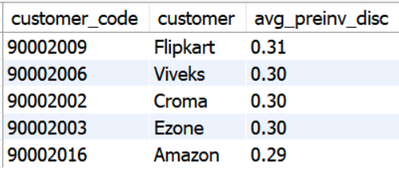
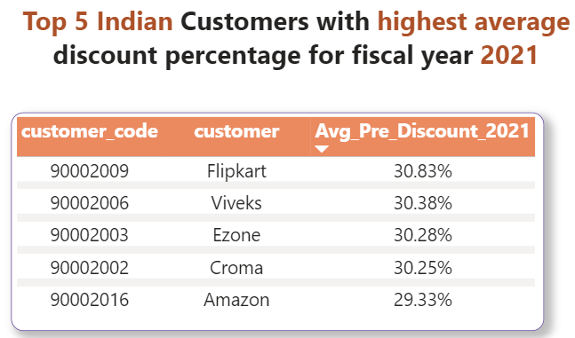
6. Generate a report which contains the top 5 customers who received an average high pre_invoice_discount_pct for the fiscal year 2021 and in the Indian market.
The final output contains these fields: customer_code, customer, average_discount_percentage
INSIGHTS
Highest Average Pre-Discount was given to Flipkart.
Lowest Average Pre-Discount was given to Amazon.

Slide 13
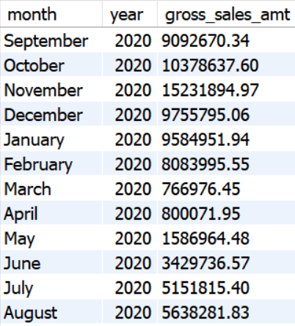
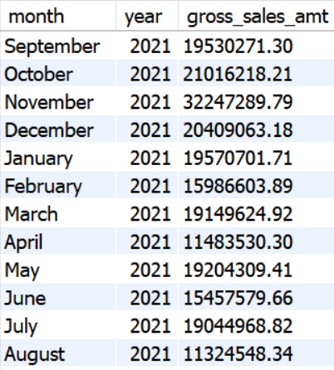
7. Get the complete report of the Gross sales amount for the customer “Atliq Exclusive” for each month. This analysis helps to get an idea of low and high-performing months and take strategic decisions. The final report contains these columns: Month, Year, Gross sales Amount
FY 2020
FY 2021
INSIGHTS
Gross Sales for the month of Nov 2020 (FY-21) was at its peak at 32.2 Mil.
Gross Sales in the month of March 2020 & 2021 was at its lowest.
The low Gross Sales was due to COVID-19 Pandemic.

Slide 14
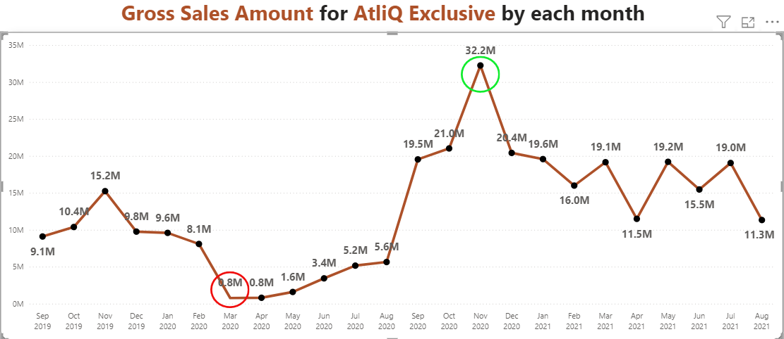
Total Gross Sales for FY-21 is 224.4 Mil which is significantly higher ( approx. 75 %) than the Total FY-20 for 79.4 Mil.

Slide 15
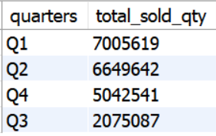
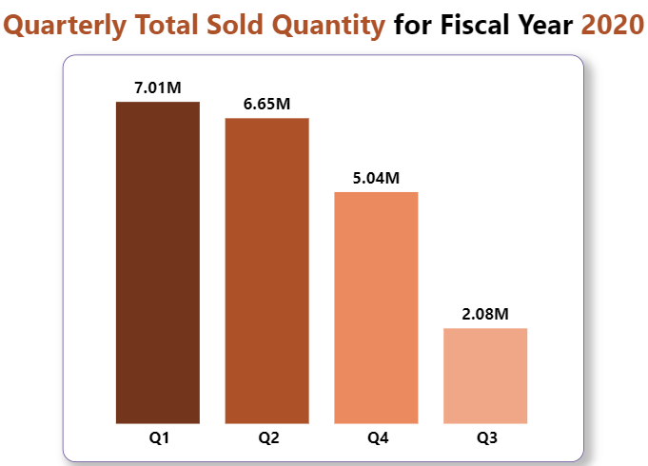
8. In which quarter of 2020, got the maximum total_sold_quantity? The final output contains these fields sorted by the total_sold_quantity: Quarter, total_sold_quantity.
INSIGHTS
In FY-20, Quarter 1 has the highest sold quantity and Quarter 3 has the lowest sold quantity.

Slide 16
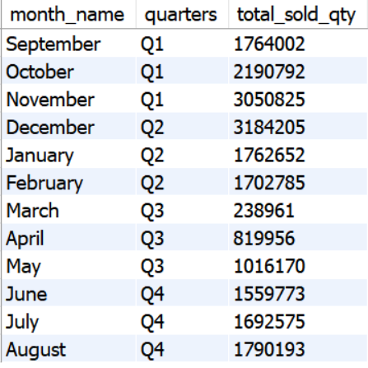
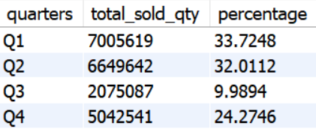
In Q2 for month December has the highest number of quantities sold.
In Q3 for the month March has the lowest number of quantities sold.
Q1 consists of (approx. 34 %) of total sold quantity, having highest quantities sold in the month of November.

Slide 17
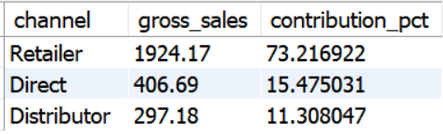
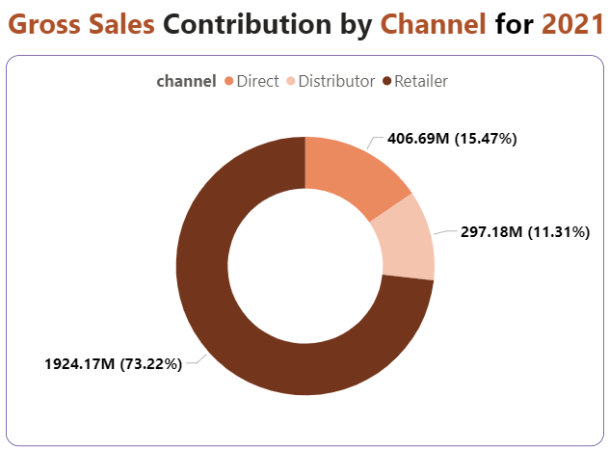
9. Which channel helped to bring more gross sales in the fiscal year 2021 and the percentage of contribution? The final output contains these fields: channel: gross_sales_mln, contribution percentage.
INSIGHTS
Retailer Channel has brought the highest Gross Sales, contribution to more than 73 %.
Distributor Channel makes the least contribution of Gross Sales at a little over 11 %.

Slide 18
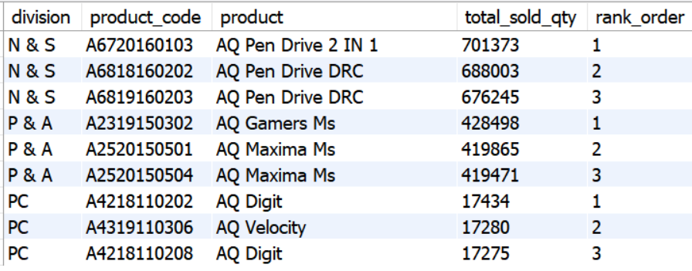
10. Get the Top 3 products in each division that have a high total_sold_quantity in the fiscal_year 2021? The final output contains these fields: division, product_code, product, total_sold_quantity, rank_order.
INSIGHTS
Compared to “N & S” and “P & A” division, the top products for “PC” division has way less quantities sold.

Slide 19
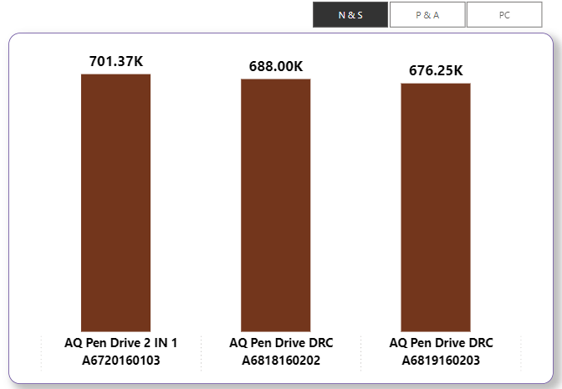
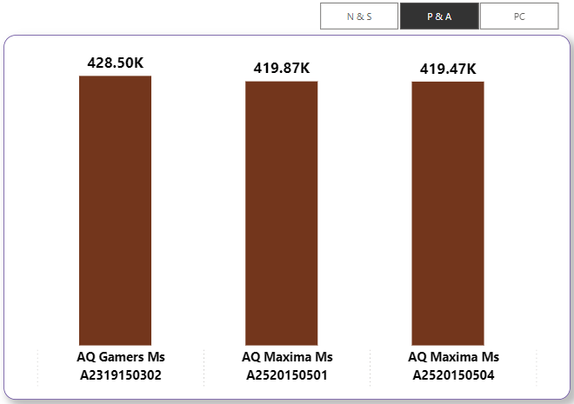
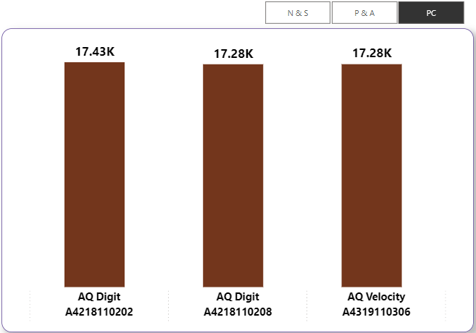

Slide 20
Thank You

